Slide 1
Career in Educational Psychology
Dr. Kathy Shum
Department of Psychology
The University of Hong Kong

Slide 2
Our impact as Educational Psychologists…
http://www.socsc.hku.hk/50/impact-stories/
Notes:
4:09
This video shows the history of the Master of Social Sciences EP program, and impact that EP could create in the society, including impact on policy making up to the highest level in the government

Slide 3
Where do EPs work?

Slide 4
The Employment Situations of our MSocSc (EP) graduates from 2012 to 2016:
Notes:
First employment settings of our graduates over the last 3 batches
Total ~ 70pp

Slide 5
What exactly does an EP do in schools?

Slide 6
Support for primary and secondary school students

Slide 7
Support for students
Assessment of learning problems
Preliminary assessment of attention, behavioural and/or emotional problems
Training and Intervention for individual or group of SEN students
Counselling
Report writing

Slide 8
Support for parents

Slide 9
Support for parents
Psychoeducation and training
Consultation on:
Parenting skills
Learning support
Support for students with SEN
Enhance home-school communication and collaboration

Slide 10
Support for teachers and social workers

Slide 11
Support for teachers and social workers
Staff development programme
Consultation on:
Case management
Curriculum design
Teaching and learning strategies
Students’ learning motivation
SEN
Classroom management

Slide 12
Support for school administrators

Slide 13
Support for school administrators
Consultation on school-based policy
Accommodation and support for SEN
Acceleration
Planning and implementation of developmental and preventive measures
Mental health
Career guidance
Risk and crisis management
Handle complaints
Mitigate risk
Support in critical incidents

Slide 14
Working with colleagues
Joint-school activities
Projects
Administrative work
Peer consultation
Emotional support

Slide 15
Primary School A
Time | Work Item
0900-0930 | Case consultation with school social worker
0930-1100 | IQ Assessment with 2A Mary
1100-1200 | Lesson Observation 4C Tom
1200-1300 | Lunch
1315-1430 | Reading and writing assessment with 3B Peter
1430-1505 | Teacher consultation on 5A Evelyn
1505-1600 | Parent feedback 2B Lenny
1615-1700 | Case conference 3A Molly
1700-1730 | Feedback and work arrangement with school social worker

Slide 16
Primary School B
Time | Work Item
0800-0900 | Preparation
0900-1200 | Teacher training: Multisensory approach of classroom teaching
1200-1330 | Lunch + Preparation
1330-1500 | P2 Chinese curriculum panel meeting
1500-1730 | P1 Case conference

Slide 17
Secondary School A
Time | Work Item
0930-1040 | Social skills training with 2A Chan
1100-1200 | Talk on study skills for F4 students
1200-1300 | Lunch
1330-1405 | Study skills training for 1B Lam
1430-1540 | Reading and writing assessment with 4C Poon
1600-1700 | Critical thinking skills group training for senior formers

Slide 18
Secondary School B (Crisis)
Time | Work Item
0900 | Receive emergency phone call from School B
0930 | Leave School A
1000-1100 | Crisis management team meeting
1100-1115 | Preparation
1115-1140 | Teacher briefing
1200-1315 | Lunch /preparation
1320-1350 | Special school assembly
1400-1530 | Special class teacher period/ psychological first aid
1600-1700 | Teacher debriefing
1700-1800 | Crisis management team debriefing

Slide 19
Scope of Service

Slide 20
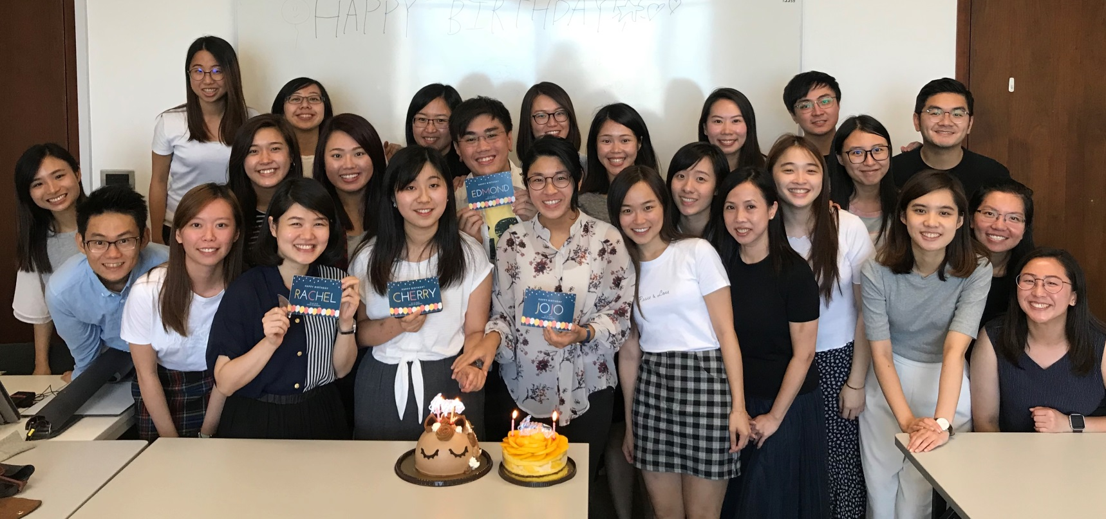
Becoming an Educational Psychologist
A Bachelor’s degree majoring in Psychology
A Master’s degree in Educational Psychology (professional training)

Slide 21
How to prepare for this career in your undergraduate study?
Relevant Courses:
Introduction to educational psychology
Life-span developmental psychology
Advanced developmental psychology
Introduction to counseling and therapeutic psychology
Research internship
Social innovative internship / service leadership internship

Slide 22
How to prepare for this career in your undergraduate study?
Relevant Experience
Voluntary work in educational or related settings
http://www.psychology.hku.hk/~main/?page_id=1549

