Slide 1


Job Placement of Psychology Major
…and more
Josephine Chan
Chief Student Advising Officer (Careers)
CEDARS- Careers & Placement
22 October, 2018

Slide 2
Employment Statistics about BSocSc Graduates Majoring in Psychology (2017, 2016)
* HKU Overall refers to the figure for the total HKU population and includes M.B.,B.S. and B.D.S. graduates.

Slide 3
Time Taken to Secure Employment
By Feb 100%
By Sept 91%
By Sept 91%
By July 58%
May or before 27%

Slide 4
Employment Sectors for 2017 Psy graduates
Civil Service
Community, Social & Personal Services
Education Institutions

Slide 5
Employment Prospects for Psy Major - Examples
Training Consultants
Human Resources Officers
Sales Manager
Research Assistants
Marketing Executives
Rehabilitation Coordinator
Behavioral Therapist
Public Relation Executives
Advertising Account Executives
Education & Teaching Roles
Graduate Trainee
Administrative Executives
Activity Officer
Business Executives
Consulting Analyst
SEN Instructors
Civil Servant EO & AO
Private Banking Analyst
Global Customer Support Representative

Slide 6
Psychology graduates go for a diverse types of jobs and industries in both private and public sectors as well as education institutions.
In fact, very few of the Psychology graduates have taken up jobs requiring Psychology background specifically (on average, less than 5 graduates each year).
Reason:
  Psychology professions usually require some working experience and hence it was challenging for fresh graduates to compete with those with relevant experience.
    -> Engage in relevant internship or part-time experiences
Psychology graduates were equipped with both technical and soft skills that different industries are looking for.
Good observation skills
Good communication
Critical thinking
Research skills
Analytical skills
Interpersonal skills
Problem solving skills
Statistical skills
Good attitude
Organizational skills
Empathy
Team work

Slide 7
CEDARS-Careers & Placement
Core Activities
Professional Preparation Programmes (PPP)
Career Education
Training Workshops (Career Planning & Preparation, Selection Exercise Training, Workplace Preparation)
Alumni Sharing
One-on-One Consultation
Collaborations (Industry Talk, Career Talk)
Placement Services
Job Postings & Daily Career Announcements
Careers Fair & Recruitment Days
Internship Opportunities & Support (Local, Mainland, Overseas)
PG Students
Recruitment Talks & Seminars
New Graduate Placement Support
Pre-selection & Interview Support
Support for Special Groups
Non-local Students
Entrepreneurship, Startup Job Fair
  Graduate Employment Survey (GES)
  Employer Survey
  Student Focus Group
Other Projects

Slide 8
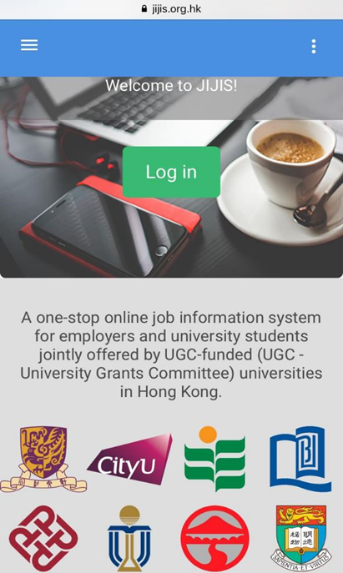
Start Your Preparation
Where can I find job postings & how can I get prepared?
Find
APPLY
WIN
Daily E-mail Announcement
http://www.cedars.hku.hk/careers/latest-announcement
JIJIS
www.jijis.org.hk
Application
Directly send to employer
or
Via CEDARS:
CEDARS support
Resources
Career/ assessment guides/MBTI
Workshops
STEER model
CV writing, Mock Interview practice
One-to-one Consultation
Full Time Career Advisors
Career Consultants
NETjobs
http://cedars.hku.hk/netjobs
Intern with Founder
www.cedars.hku.hk/internwfounder
Job Fairs
Application
CEDARS
Screening
Employer
Job Market (JobsDB, etc.)

Slide 9

CEDARS Global Career Springboard Scheme (CGCSS)
Career Exploration Programmes
(1-3 weeks)
Paid/Non-paid Internships
(3-8 weeks)
CGCSS - Global Career Learning Experience
www.cedars.hku.hk/careerspringboard
Government / NGOs
Educational Institutions
Corporations
Startups
Company Visits
Workshops
Job Shadowing / Project Learning
Networking with Locals

Slide 10
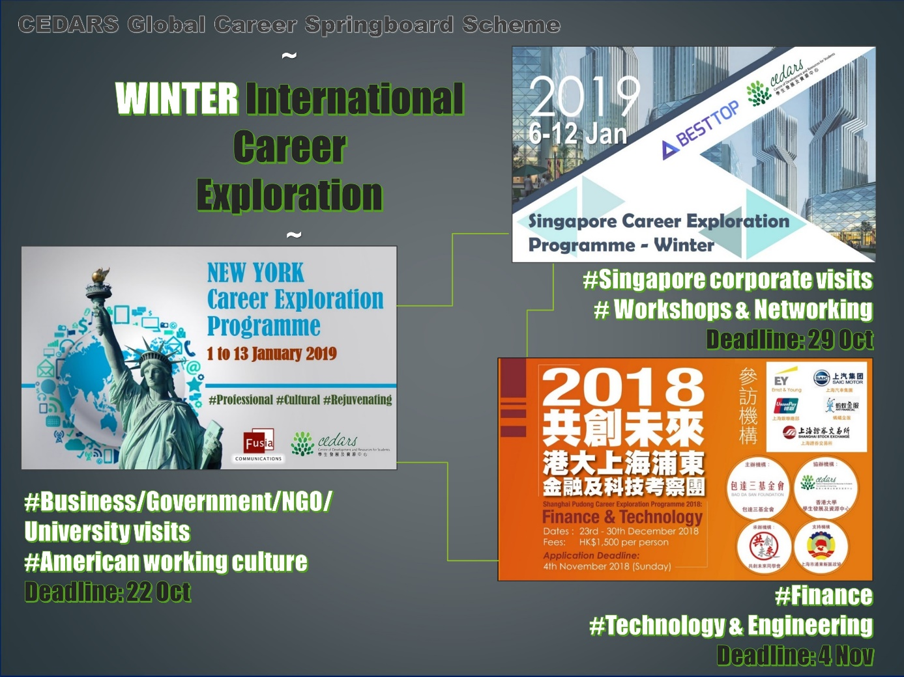

Career Exploration Programmes – Winter

Slide 11
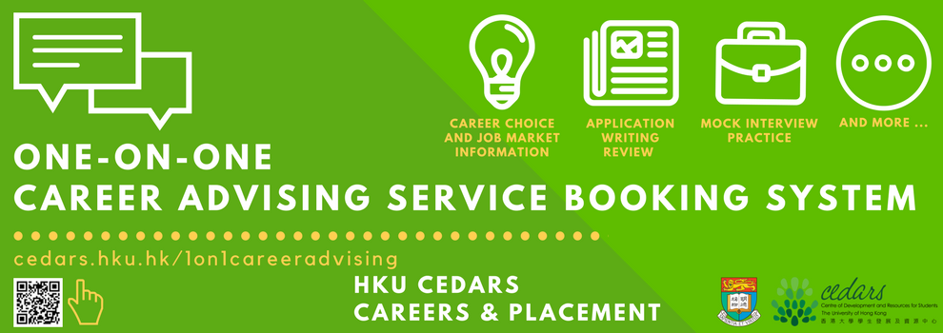
HKU CEDARS
Careers & Placement
One-on-One Career Advising Service
Booking System
Make an appointment to meet with our
Career Consultants at your fingertips
http://cedars.hku.hk/1on1careeradvising

Slide 12

HKU CEDARS
Career Digest @WhatsApp

Slide 13

Contact Us | Q&A
3/F Meng Wah Complex, The University of Hong Kong,
Pokfulam Road, Hong Kong
3917 2317
careers@hku.hk
http://cedars.hku.hk
Recruitment Talks
One-on-one Consultation
Training Workshops
And More…

